Slide 1
CS 4476/7646 Project 2
Tarun Pasumarthi
tpasumarthi3@gatech.edu
903085537

Slide 2
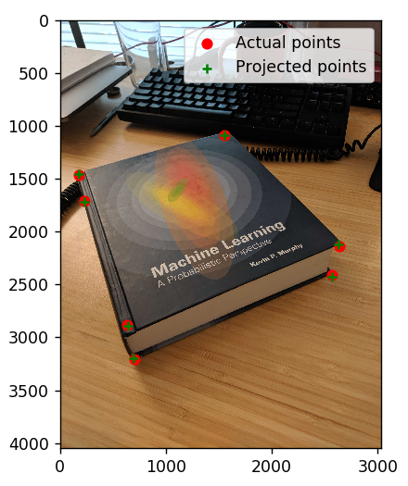
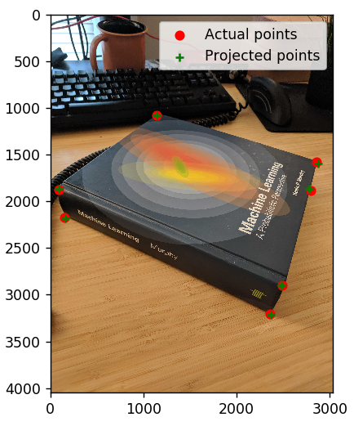

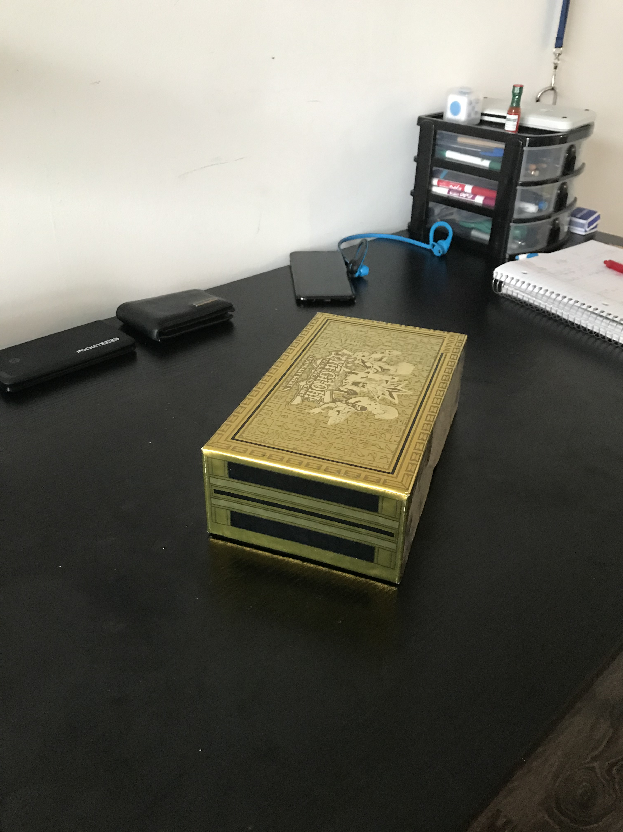
Part 1: Projection Matrix
<insert visualization of projected 3D points and actual 2D points for image provided by us here>
< insert the two images of your fiducial object here>

Slide 3
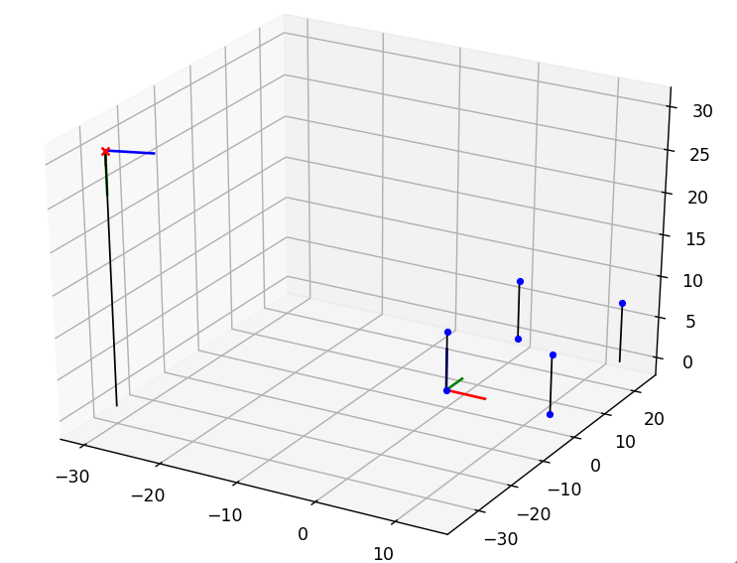
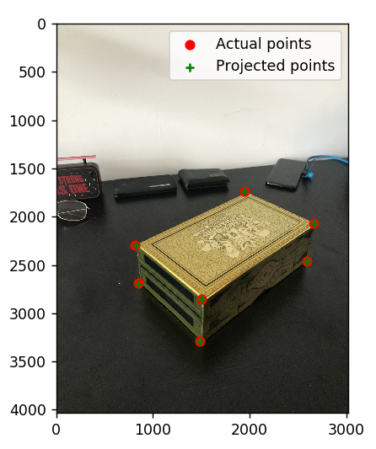
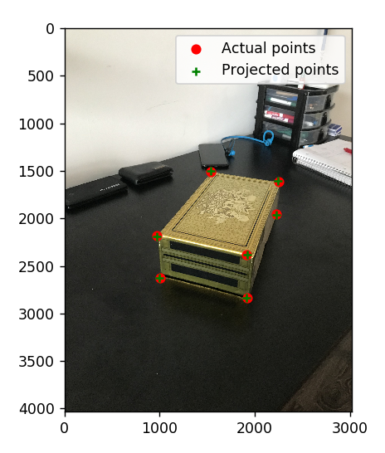
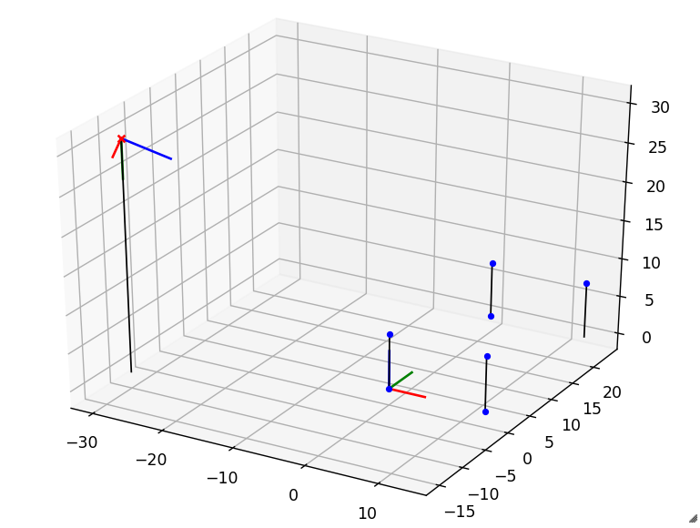
Part 1: Projection Matrix
<insert visualization the initial guesses for rotation matrix and camera center for the two images here>
<insert visualization of projected 3D points and actual 2D points for both the images you took>

Slide 4
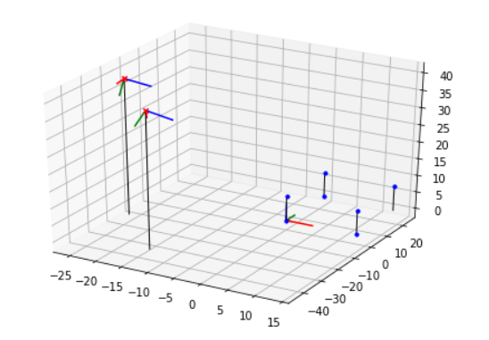
Part 1: Projection Matrix
<insert visualization of both camera poses here>

Slide 5
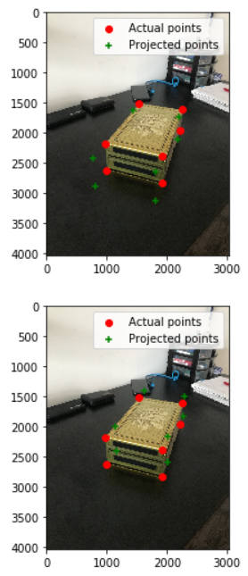
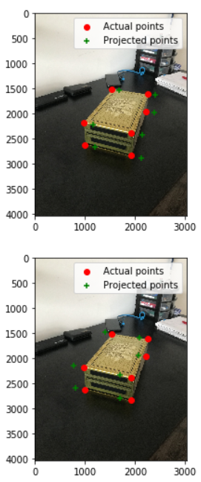
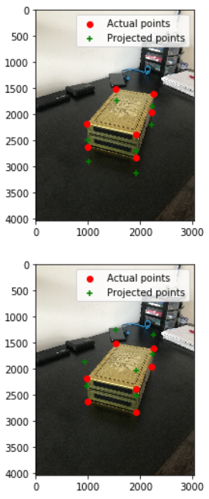
Part 1: Projection Matrix
X-axis of camera center t +3 (above)
X-axis of camera center t -3 (below)
Y-axis of camera center t +5 (above)
Y-axis of camera center t -5 (below)
Z-axis of camera center t +5 (above)
Z-axis of camera center t -5 (below)
If you were to increase the x-coordinates or any other coordinates of the camera center t, the projected points should move down on the respective axis in the real world. So in the image this would be moving down the line that corresponds to the vanishing point of the given axis. Similarly, decreasing any of the coordinates of the center, should move the projected points up on the respective real-world axis, which in the image would be moving up the line corresponding to the vanishing point of that given axis.

Slide 6
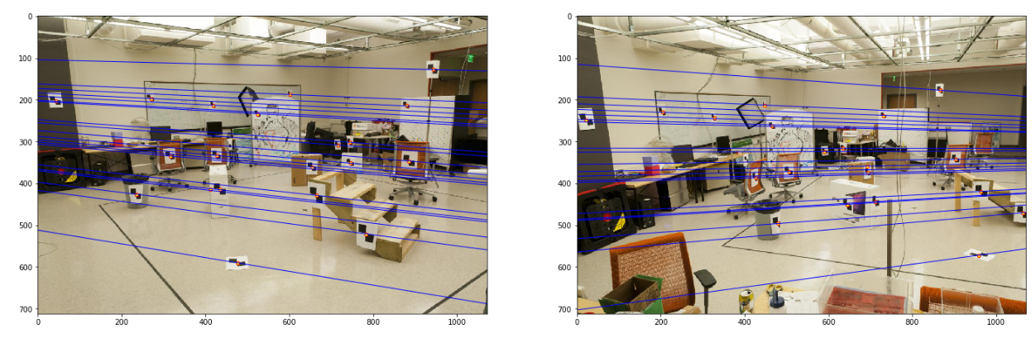
Part 2: Fundamental Matrix Estimation
Room: Left Image with Epipolar Lines
Room: Right Image with Epipolar Lines

Slide 7
Part 2: Fundamental Matrix Estimation
Fundamental Matrix Estimation Result:
[[-0.00005608 0.00059327 -0.014601 ]
[ 0.00087223 -0.00015445 -2.39641427]
[-0.22260075 1.74869963 57.12943309]]

Slide 8
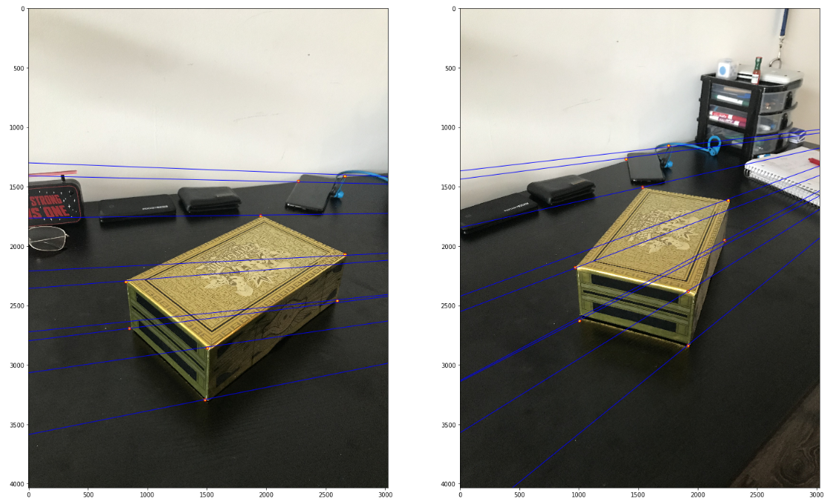
Part 2: Fundamental Matrix Estimation: Your Images
Your Image: Left Image with Epipolar Lines
Your Image: Right Image with Epipolar Lines

Slide 9
Part 2: Fundamental Matrix Estimation: Your Image
Fundamental Matrix Estimation Result:
[[ -0.00005366 -0.0005305 0.83333035] [ 0.00125642 -0.00048652 -4.93357538] [ -1.19089577 5.90673263 -468.75343629]]

Slide 10
Part 2: Reflection Questions
1. Epipoles are the where the camera center projects on the image plane of the other camera. So a rotated image or a zoomed image would have the same camera center compared to the original, and therefore we would not able to calculate a viable epipole, epipolar lines, and fundamental matrix.
2. Since the depth of the given point is not known, the point in a given image could correspond to any point on a given line on the other image. This is why a point in one image would correspond to a line in the other image.
3. When you have two images with camera centers in the images, you get two epipoles that are displayed within each of these images, so all the epipolar line converge at a point in each of the images, which corresponds to the epipoles.
4. Horizontal epipolar lines mean both cameras are facing outward and are side by side. The epipoles are infinitely far away.
5. The fundamental matrix is defined up to a scale as given x’Fx=0, and scalar a: x’(aF)x=0, x’Fx= a0, x’Fx=0, so there are infinitely many matrices that satisfy the equation, but all with the same scale.
6. Since the epipole itself lies on the epipolar line, eF= 0, F has a null space which is not the zero vector. So it is rank deficient and is of rank 2.

Slide 11
Part 2: Extra Credit: Fundamental Matrix Song
Reflect on the Fundamental Matrix Song
Link here: https://www.youtube.com/watch?v=DgGV3l82NTk
I have learned that songs are a great way to capture some fundamental points (pun intended) of a given topic. Specifically I’ve leaned properties of the fundamental matrix, such as having 7 degrees of freedom, being of rank 2, x’Fx=0, null(F)=e, null(Fh)=e’, all epipolar lines pass through epipoles, and three views allow trifocal tensors with additional properties. Furthermore, I aspire to be as cool as the creators of this song, one day.

Slide 12
Part 3: RANSAC Iterations Questions
Delete the questions and type your answers to the three RANSAC Iterations questions from the jupyter notebook below:
14 iterations are needed
If we used 18 points, we would need 42 iterations
If our dataset had a 70% point correspondence accuracy, we would need 167 iterations

Slide 13
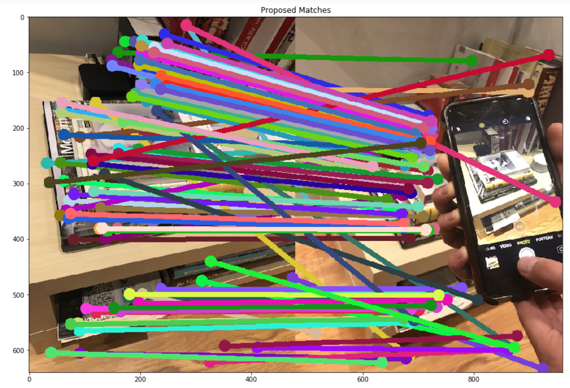
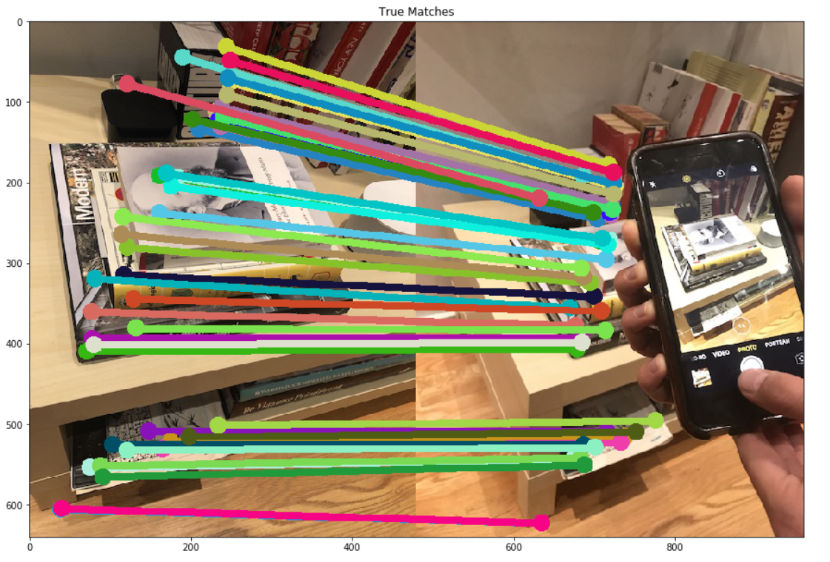
Part 3: RANSAC Inlier Matches
Paste two sets of images: displaying matches loaded from disk; and inlier matches after RANSAC

Slide 14
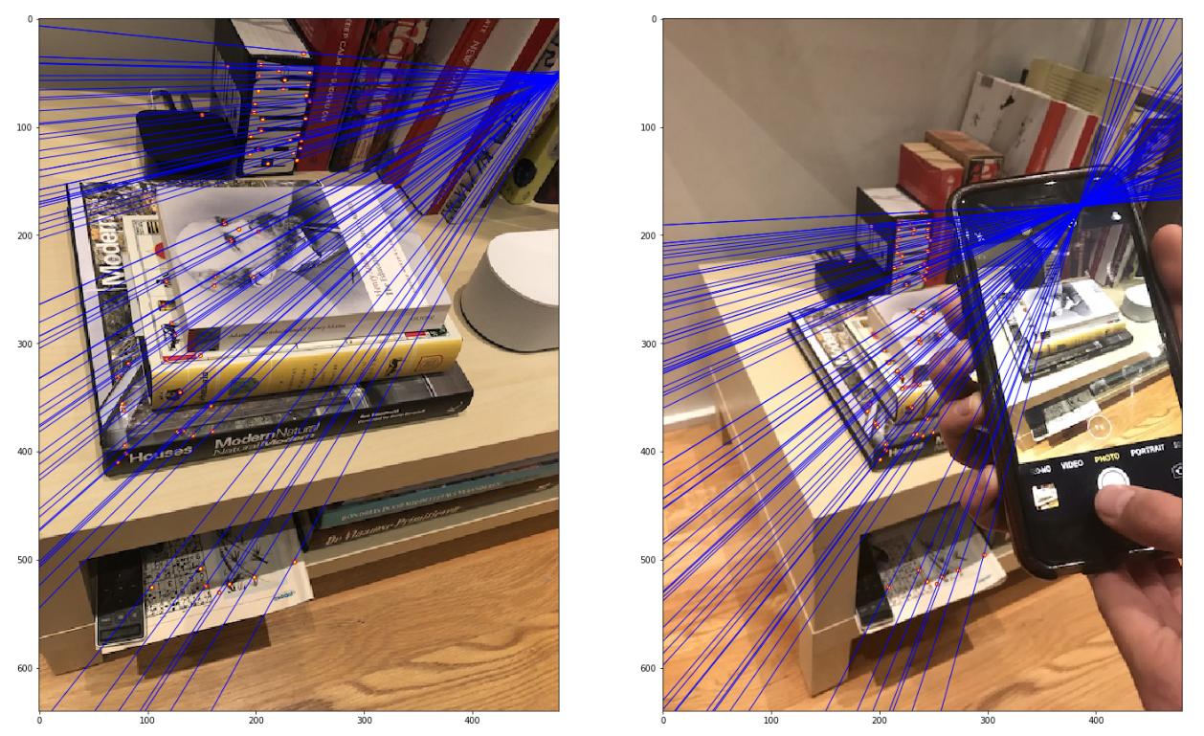
Part 3: RANSAC Implementation

Slide 15
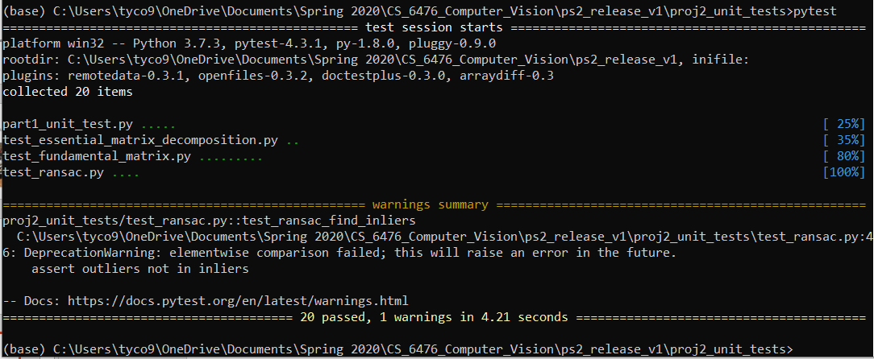
Tests
<Provide a screenshot of the results when you run `pytest` from the unit tests directory with your final code implementation (note: we will re-run these tests).>

Slide 16
Conclusions
In this project, I have learned how to map 3-d real world points into 2-d image coordinates using the projection matrix, I have learned the relation between the camera center, rotation matrix, intrinsic matrix, and projection matrix, I have learned how to derive the fundamental matrix using corresponding points among two images, I have learned the relation between the fundamental and essential matrix, I have leaned how to calculate the number of RANSAC iteration needed to produce an inlier set with a given probability, and I have learned how to estimate and fine tune a fundamental matrix using the RANSAC algorithm. This was a very informative assignment, and it has helped me grasp some of the concepts that were confusing during lecture. I did not face many challenges, as the assignment was clear and provided helpful instructions.

